Slide 1

AQUA ANALYSTS
Drshika Chenna, Mrinalika Ampagowni, Shraddha Gangaram and Tanvi Nair

Slide 2
01
Introduction & Dataset Overview
02
ANALYSIS OBJECTIVEs
03
Data preparation & cleaning
CONTENTS
04
Visual Data insights
05
Regression modelling
06
Future research & CONCLUSION

Slide 3
01
Introduction & dataset Overview

Slide 4
Water scarcity affects billions worldwide, driven by population growth, agriculture, and climate variability.
Our analysis aims to uncover how different factors — like rainfall, industrial use, and groundwater depletion — influence total water consumption globally.
Time Period: 2000 to 2024
Scope: 20 countries, 500 observations
Variables: 9 total (1 response variable + 8 predictors)
Source: Kaggle (Global Water Consumption Dataset)

Slide 5
02
ANALYSiS OBJECTIVE

Slide 6
ANALYSIS QUESTIONS:
Are any predictors statistically significant in explaining total water consumption?
How does total water consumption differ by water scarcity level (low, moderate, high)?
Has total water consumption changed across the time periods 2000–2008, 2009–2016, and 2017–2024?
How do agricultural, industrial, and household water use relate to total water consumption?
Does increased rainfall correspond to lower groundwater depletion?

Slide 7
03
Data Preparation and Cleaning

Slide 8

Data PREprocessing & Cleaning:
Before modeling, we performed light preprocessing on the cleaned dataset. No missing values were detected, and all variables were already well-structured.
Checked for missing data using colSums(is.na(df))
→ Result: No missing values present
Converted categorical variables to numeric to support modeling:
"Country" and "Water Scarcity Level" were converted from factor to numeric
"Year Group" was created to group individual years into three meaningful time periods:
2000–2008, 2009–2016, and 2017–2024
Renamed columns to improve clarity and visual presentation (e.g., from "Industrial.Water.Use...." to "Industrial Water Use")

Slide 9
04
Visual Data insights

Slide 10
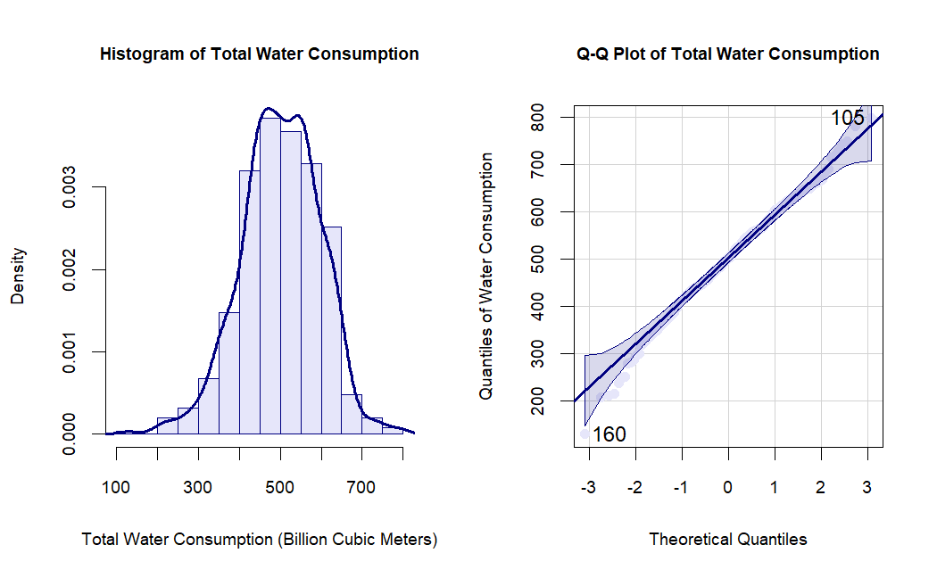
Histogram of Total Water Consumption
This histogram displays the frequency distribution of total water consumption (in Billion Cubic Meters).
The blue line overlaid on the histogram is a density curve (a smoothed version of the distribution).
The shape is approximately bell-curved, indicating a normal-like distribution, but with slight skewness to the left.
Interpretation:
Most values of total water consumption fall between 400 and 600 billion cubic meters.
The distribution is roughly symmetric, with a slight peak and minor skew.
The presence of a smooth density curve suggests the data is relatively continuous and could be appropriate for normal-based statistical analysis.

Slide 11
Q-Q Plot of Total Water Consumption
The Q-Q Plot Compares actual water consumption data to a normal distribution
Most points align with the diagonal line → middle values are roughly normal
There are deviations at the ends (e.g., ~160 and ~105) → slight non-normality in tails
This suggests that the data is mostly normal with minor irregularities at extremes.
Interpretation:
The middle quantiles (central data points) closely follow the line, indicating that the central distribution is approximately normal.
The tails deviate slightly, especially at the low end (~160) and high end (~105), suggesting mild non-normality or outliers in extreme values.
Overall, this indicates the data is approximately normally distributed, but with slight deviations at the tails.

Slide 12

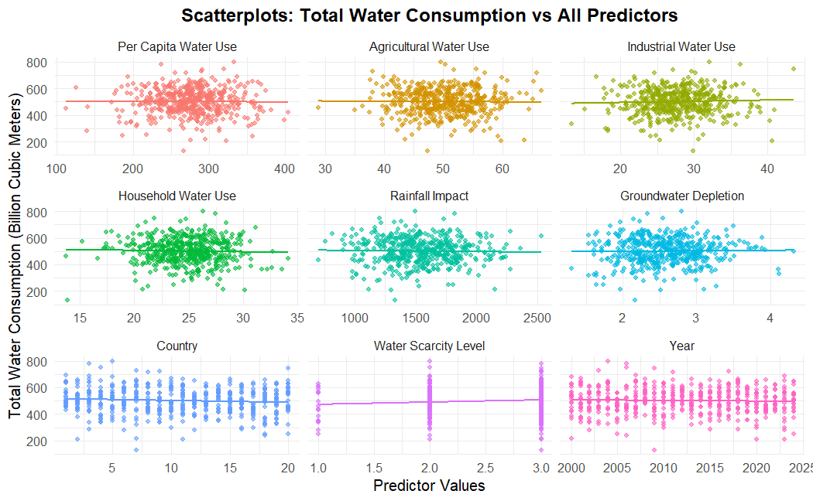

Slide 13
Per Capita Water Use:
The points are dispersed, and the trend line is mostly flat.
Interpretation: Weak or no clear linear relationship with total water consumption.
Agricultural Water Use :
Points are dense around the mean; trend line is flat.
Interpretation: No clear trend.water use for agriculture doesn’t strongly predict total consumption linearly.
Industrial Water Use: Flat trend line.
Interpretation: No clear trend.water use for agriculture doesn’t strongly predict total consumption linearly.
Household Water Use
Weak, possibly slightly positive linear pattern.
Interpretation: Weak-to-moderate positive association.
Rainfall Impact
The trend line is flat.
Interpretation: No meaningful linear relationship between rainfall and water consumption.
Groundwater Depletion
Mostly flat trend.
Interpretation: Again, no strong relationship with total water use.
Country (encoded 1–20)
Trend line is flat; points spread evenly.Interpretation: No one country dominates the total water usage trend — consistent with balanced data or dummy-coded variables.
Water Scarcity Level (likely ordinal: 1, 2, 3) Slightly Upward Trend
Interpretation: Scarcity level could possibly predict total use.
Year (2000–2025): Slight upward trend, but noisy.
Interpretation: Over time, total water consumption may be slowly increasing, though variability is high.

Slide 14
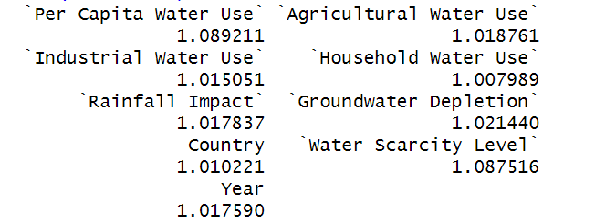
Variance Inflation Factor (VIF) analysis
To assess multicollinearity among the nine predictors in our multiple linear regression model
All VIF values ranged between 1.008 and 1.089, indicating very low correlation among predictors.
Since all VIFs are well below the common threshold of 5, we concluded that:
There is no multicollinearity concern
All variables can be safely included in the regression model
This ensures that our coefficient estimates are stable and reliable, allowing us to interpret the model without needing to remove or combine any predictors.

Slide 15
05
Regression Modeling

Slide 16
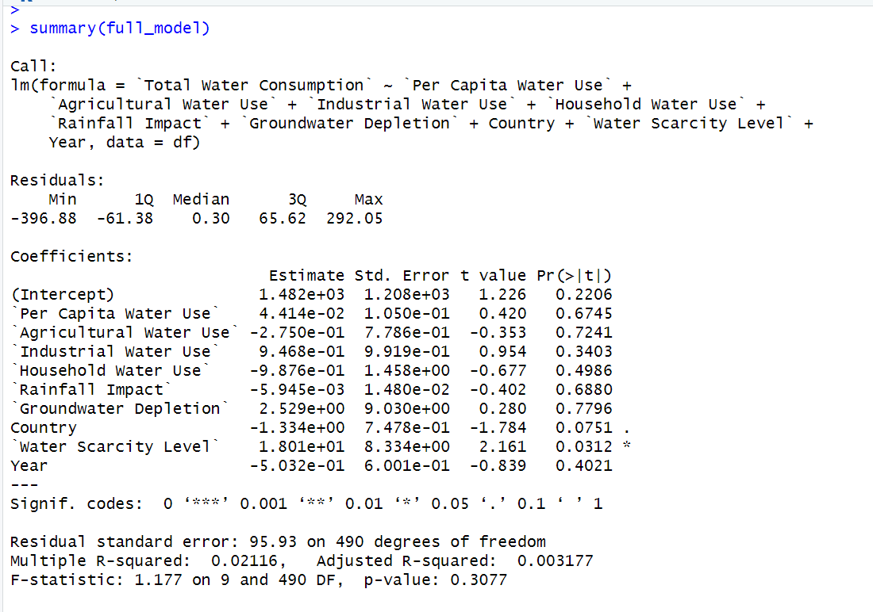

Slide 17
We fit a multiple linear regression model using nine predictors to explain variation in Total Water Consumption across countries and years.
Key Findings:
The only statistically significant predictor was Water Scarcity Level (p = 0.0312), suggesting that water scarcity classification meaningfully affects a country’s total water consumption.
All other predictors, including Per Capita Water Use, Agricultural Use, Rainfall, and Year, had p-values > 0.05, indicating no strong individual effects in this model.
The Adjusted R² = 0.0032, implies that the model explains less than 1% of the variation in water consumption.
This suggests that while Water Scarcity Level has some explanatory power, the current model may be missing key predictors or the relationship is more complex (nonlinear or interaction effects).
Conclusion: Although multicollinearity is not an issue (VIFs all < 1.1), the overall model has low explanatory power, and most predictors are not statistically significant.

Slide 18
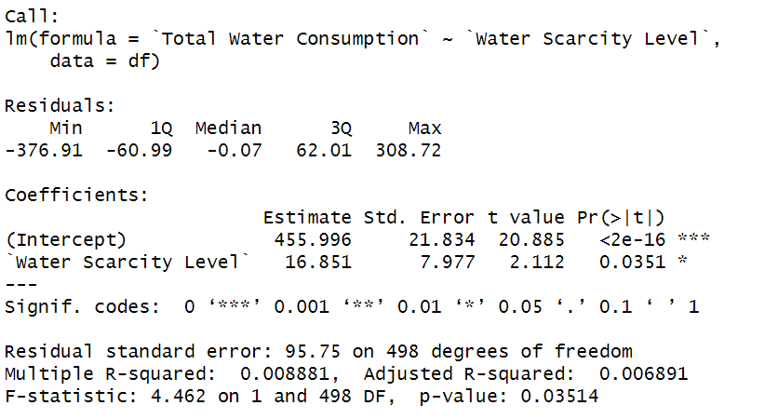

Slide 19
Regression Equation
This means the model is:
Total Water Consumption = 455.996 + 16.851 × Water Scarcity Level
So, for every 1-unit increase in water scarcity level, total water consumption increases by ~16.85 billion cubic meters. 455.996 is the intercept which represents the theoretical predicted total water consumption when the water scarcity level = 0 (but level 0 doesn’t occur in real data).
Coefficient Significance
t value = 2.112
p-value = 0.0351
Since p < 0.05, the effect of Water Scarcity Level is statistically significant at the 5% level, but only marginally.
Interpretation : There's some evidence that Water Scarcity Level is positively associated with total water consumption — but the effect is small and not highly robust.

Slide 20
R-squared
Multiple R-squared = 0.008881 (less than 1%)
Adjusted R-squared = 0.006891
This means that only ~0.9% of the variation in Total Water Consumption is explained by Water Scarcity Level. Statistically significant, but not practically useful alone.
Water scarcity explains very little of the behavior of water consumption in the data.
Residual Standard Error & F-test
Residual Std. Error = 95.75 → moderately large spread in errors
F-statistic = 4.462, p-value = 0.03514
→ model is significant (barely), confirming the t-test

Slide 21
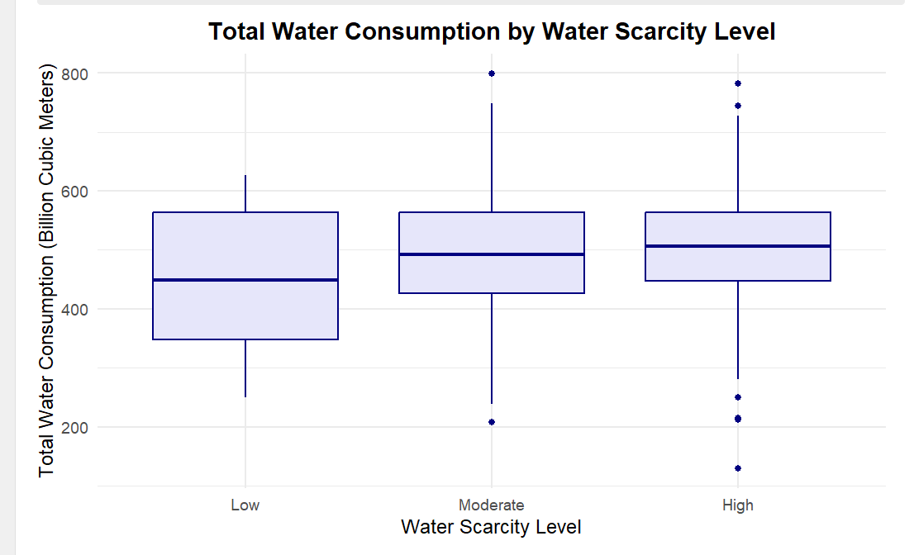

Slide 22
This boxplot compares Total Water Consumption across countries with different Water Scarcity Levels.
We observe that:
Countries with Moderate scarcity have a wide range of water use, including some of the highest consumption outliers.
The median water consumption appears similar across groups, but variability is larger for Moderate scarcity.
Despite expectations, countries with High scarcity (if present) may not necessarily use less water — potentially due to high demand or poor efficiency.
This supports our regression finding that Water Scarcity Level is statistically significant, though more factors may influence consumption.

Slide 23
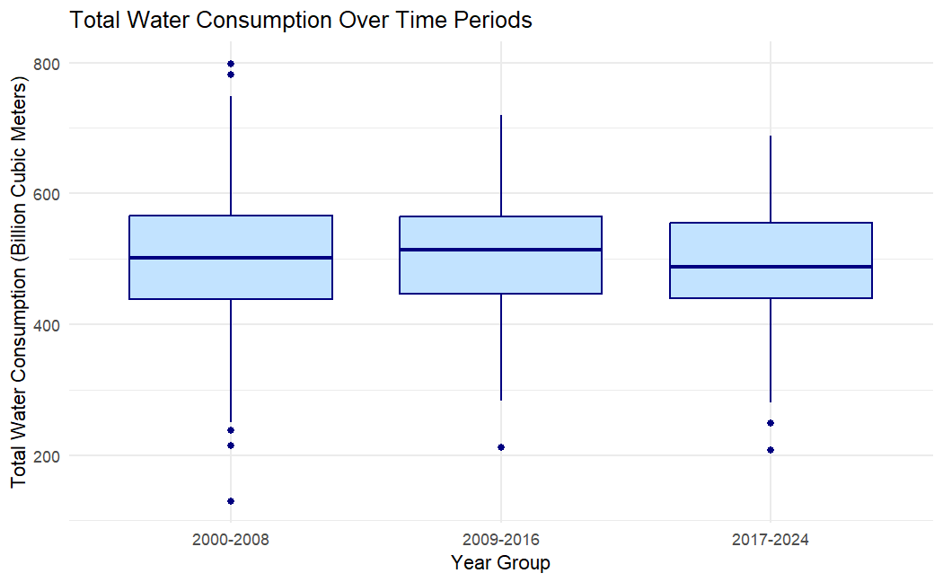
Total Water Consumption Over Time (2000–2024)
2000–2008: Greatest spread (IQR) and both extreme low (~130 bcm) and high (~800 bcm) outliers
2009–2016: Spread remains similar, fewer extreme lows, consumption more clustered around the median
2017–2024: Slightly narrower IQR, low-end outliers persist, high-end variability reduced
Overall Interpretation
Water use peaked in the mid-period (2009–2016) and has shown a modest decline since 2017
Despite slight fluctuations, total consumption remains relatively stable around 500 bcm
Outliers suggest occasional spikes or drops—potentially driven by droughts, policy changes, or data anomalies

Slide 24
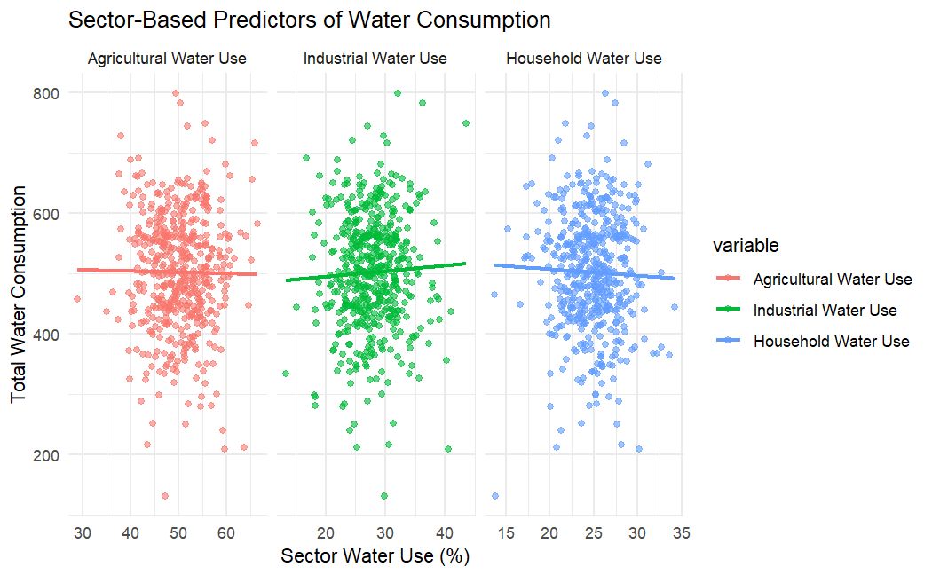

Slide 25
Sector-Based Predictors of Water Consumption
The previous scatterplots show how agricultural, industrial, and household water use relate to total water consumption
Agricultural Water Use
Points are densely packed around the mean
Interpretation: Agricultural usage percentages vary, but they don’t significantly influence total consumption in a linear way
Industrial Water Use
Slight upward green trend line → weak positive association
Interpretation: As industrial use increases, total water consumption may slightly increase, though the effect is minimal
Household Water Use
Slight downward blue trend line → very weak or no linear pattern
Interpretation: Higher household water use doesn't strongly predict total consumption either

Slide 26
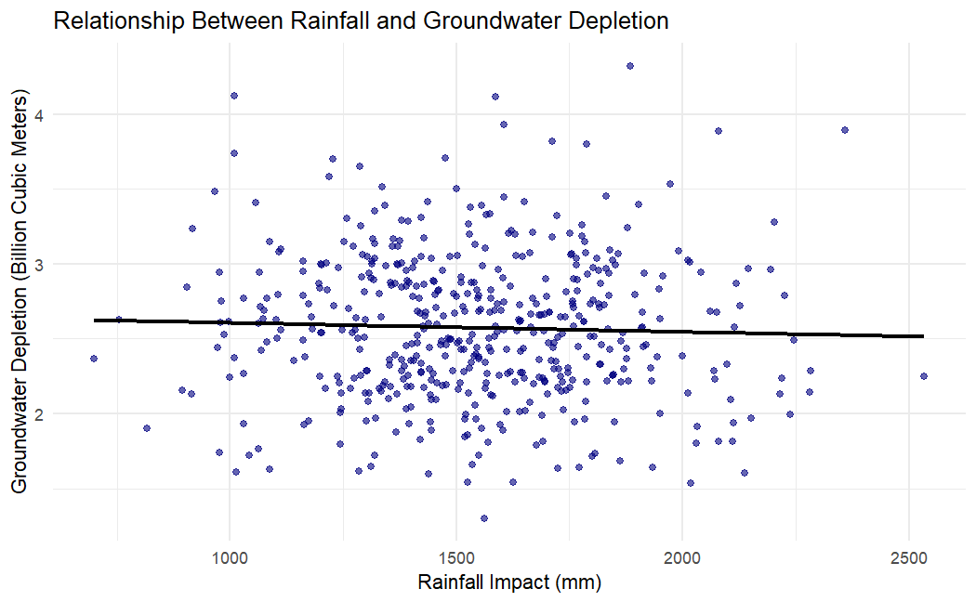
Rainfall vs. Groundwater Depletion
The scatter plot shows a weak relationship between rainfall and groundwater depletion, indicated by the flat trend line.
Rainfall explains little of the variation in depletion, suggesting other factors like water use or policy are more impactful.
The dense clustering of points suggests consistent groundwater usage patterns, regardless of natural rainfall variability.
Across rainfall values (800–2500 mm), groundwater depletion stays fairly consistent (5–30 billion m³). Even with high rainfall (~2000+ mm), depletion doesn’t drop significantly, reinforcing that rainfall isn’t too strong of a predictor of groundwater trends.

Slide 27
Real-World Factors Likely Missing from Our Data:
Government policy: Subsidies, water pricing, or conservation programs can drastically shape consumption.
Cultural habits: Differences in water use behaviors (e.g., industrial vs. domestic priorities) vary across regions.
Infrastructure quality: Leakage, inefficiency, and distribution systems impact usage but weren’t measured.
Geopolitical access: Cross-border rivers, conflict zones, and trade agreements affect availability and usage.
Why Quantitative Inputs Weren’t Enough:
While we included agricultural, industrial, and household consumption rates, these values don’t capture how resources are managed or how demand is constrained.
Additionally, climate and rainfall alone don’t explain use if storage and access are unequal.
Understanding global water use requires combining quantitative data with contextual, policy, and behavioral insights — which opens up opportunities for further research beyond this model.

Slide 28
06
Future research & conclusion

Slide 29
Conclusion :
Our analysis revealed that Water Scarcity Level was the only statistically significant predictor of total water consumption, though its effect was small and not highly practical.
Most other variables — including rainfall, sector-based use, and time — showed no strong linear relationships, and the regression model explained less than 1% of variation.
Despite this, the project highlights the importance of asking the right questions and confirms that quantitative metrics alone are insufficient to explain global water usage patterns.
For Future Research :
Integrate policy and infrastructure data (e.g., water pricing, access, leak rates) to capture how water is managed in practice.
Include population and economic indicators to better represent demand-side pressure.
Explore nonlinear models or machine learning approaches that may uncover more complex relationships between predictors.
Collect county-level case studies or regional datasets with higher resolution to explore patterns in smaller geographic units

Slide 30
Thanks for listening !

